Slide 1
Phonics is:
making connections between the sounds of our spoken words and the letters that are used to write them down.
Notes:
Slide purpose:
To give a a simple definition of phonics
Suggested script:
As you will remember from last year ...
Read the slide.
It sounds complicated but it really isn’t!
Let's review some of the important words that will help you understand phonics ...

Slide 2
Terminology
Phoneme
Blend
Grapheme
Segment
Digraph
Adjacent consonant
Trigraph
Split digraph
Notes:
Slide purpose:
To give simple definitions of key terminology
Suggested script:
Review what each word means – use the Glossary to help.
Children will have already learned most of these terms. In Year 1, split digraphs are introduced.

Slide 3
Let’s say the Phase 5 sounds- watch video 2 mins
Notes:
Slide purpose:
To introduce the Phase 5 GPCs and how to say them
Suggested script:
Let's have a look at the Phase 5 sounds.
Hand out the Phase 5 handout and the ‘Grow the code’ mat.
Play the video and pause it so the parents can say the sounds if you wish.
Or display the ‘Grow the code’ chart and teach the parents the sounds.
Have a look at your handout and watch this video/look at the ‘Grow the code’ chart on the screen.
Now, let's have a practice!

Slide 4
This term we are teaching Phase 5- watch video 2 mins
In Phase 5 children learn:
new graphemes for the sounds they already know
that the same grapheme can have alternative pronunciations.
The ‘Grow the code’ lessons support children with reading and spelling these alternative spellings.
Notes:
Slide purpose:
To provide an overview of Phase 5 'Grow the code’
Suggested script:
The children learn the last set of graphemes, including ones with alternative pronunciations.
Play the video which explains how we teach Phase 5. (The first 20 seconds are a repeat of the ‘How to say the sounds’ video but then goes on to explain what the alternative graphemes are for the sound /ai/.)
They will also learn to ‘Grow the code’ where children will explore different ways of spelling the same phoneme and reading the same grapheme. This means that they are able to read increasingly challenging words and books.
Children learn strategies so that they can distinguish between the same grapheme, different phoneme and the same phoneme but different grapheme. ‘Growing the code’ will support children as they get older with accurate spelling.

Slide 5
Reading words
Children will be able to:
blend independently
blend in their heads with increasing fluency and confidence.
They will also begin to distinguish between different phonemes/graphemes.
Notes:
Slide purpose:
To introduce the strategies that children need to become fluent readers
Suggested script:
Most children will now be confident using the strategy ‘blend in your head’ to build their fluency.
Blending in your head means children say the sounds quietly in their heads and then read the whole word out loud.
If your child is struggling with a word, encourage them to blend in their head.
Children are also taught to spot digraphs in words before reading the word as a whole. This also helps their developing fluency.
Show parents how to spot digraphs in words. Show a word such as ‘head’. Point to ‘ea’ and say: This is a digraph. Model reading the word: h-ea-d head. Show another word e.g. ‘bread’. Ask parents to spot the digraph and read the word: b-r-ea-d bread.
Eventually, reading becomes automatic and children will be able to read words that they know fluently.
Fluency is the ultimate goal of phonics teaching and fluent reading is explicitly taught.

Slide 6
Tricky words- 3 mins- watch video
Notes:
Slide purpose:
To introduce tricky words
Suggested script:
So, what are tricky words?
Have a look at this video on the website: https://www.littlewandlelettersandsounds.org.uk/resources/for-parents/
It's important that children practise tricky words regularly to ensure that they can read them automatically.

Slide 7
Spelling
This term, your child will be taught how to spell words every day using the graphemes they have been taught so far.
They will practise writing a dictated sentence.
Handwriting is referred to but is taught at other times of the day.
Notes:
Slide purpose:
To introduce spelling
Suggested script:
In Year 1, there are increasingly challenging words to spell, e.g. longer words, compound words, plurals. This all matches the Little Wandle sequence of learning.
The children will also practise writing a dictated sentence on a Friday. Their teacher will say the sentence, show them how to write it and then ask the children to write it independently.
Handwriting phrases learned in Reception are referred to during the lesson, but the specific practice of handwriting is taught separately.

Slide 8
Spelling
Say the word.
Segment the sounds.
Count the sounds.
Write them down.
Notes:
Slide purpose:
To provide an overview of spelling
Suggested script:
Model the process above on a flipchart for the parents to see. Use a Phase 5 word, e.g. ‘play’.
If you wish to support your child at home with their spelling, this is the process to use.
There are also Phase 5 weekly spellings for additional practice, which we may use outside of phonics lessons to reinforce the children's learning.

Slide 9
How do we teach reading in books?
Reading practice sessions are:
taught by a trained teacher/teaching assistant
taught in small groups.
Notes:
Slide purpose:
To introduce decodable readers
Suggested script:
The children apply their phonic knowledge to reading a decodable book.
Books are carefully matched to children’s secure phonic knowledge.
They read the same book three times in a week.
The first time we work on decoding (sounding out) the words.
The second time we work on prosody which is reading with expression – making the book sound more interesting with our ‘storyteller voice’ or our ‘David Attenborough’ voice.
The third time we look at comprehension – understanding the text.
We read the books three times at school because we want to develop the fluency. The more children see words, the more they begin to read them automatically without having to sound them out, which is the ultimate goal.
Children’s book will then be sent home, so that they can practise their fluency further.

Slide 10
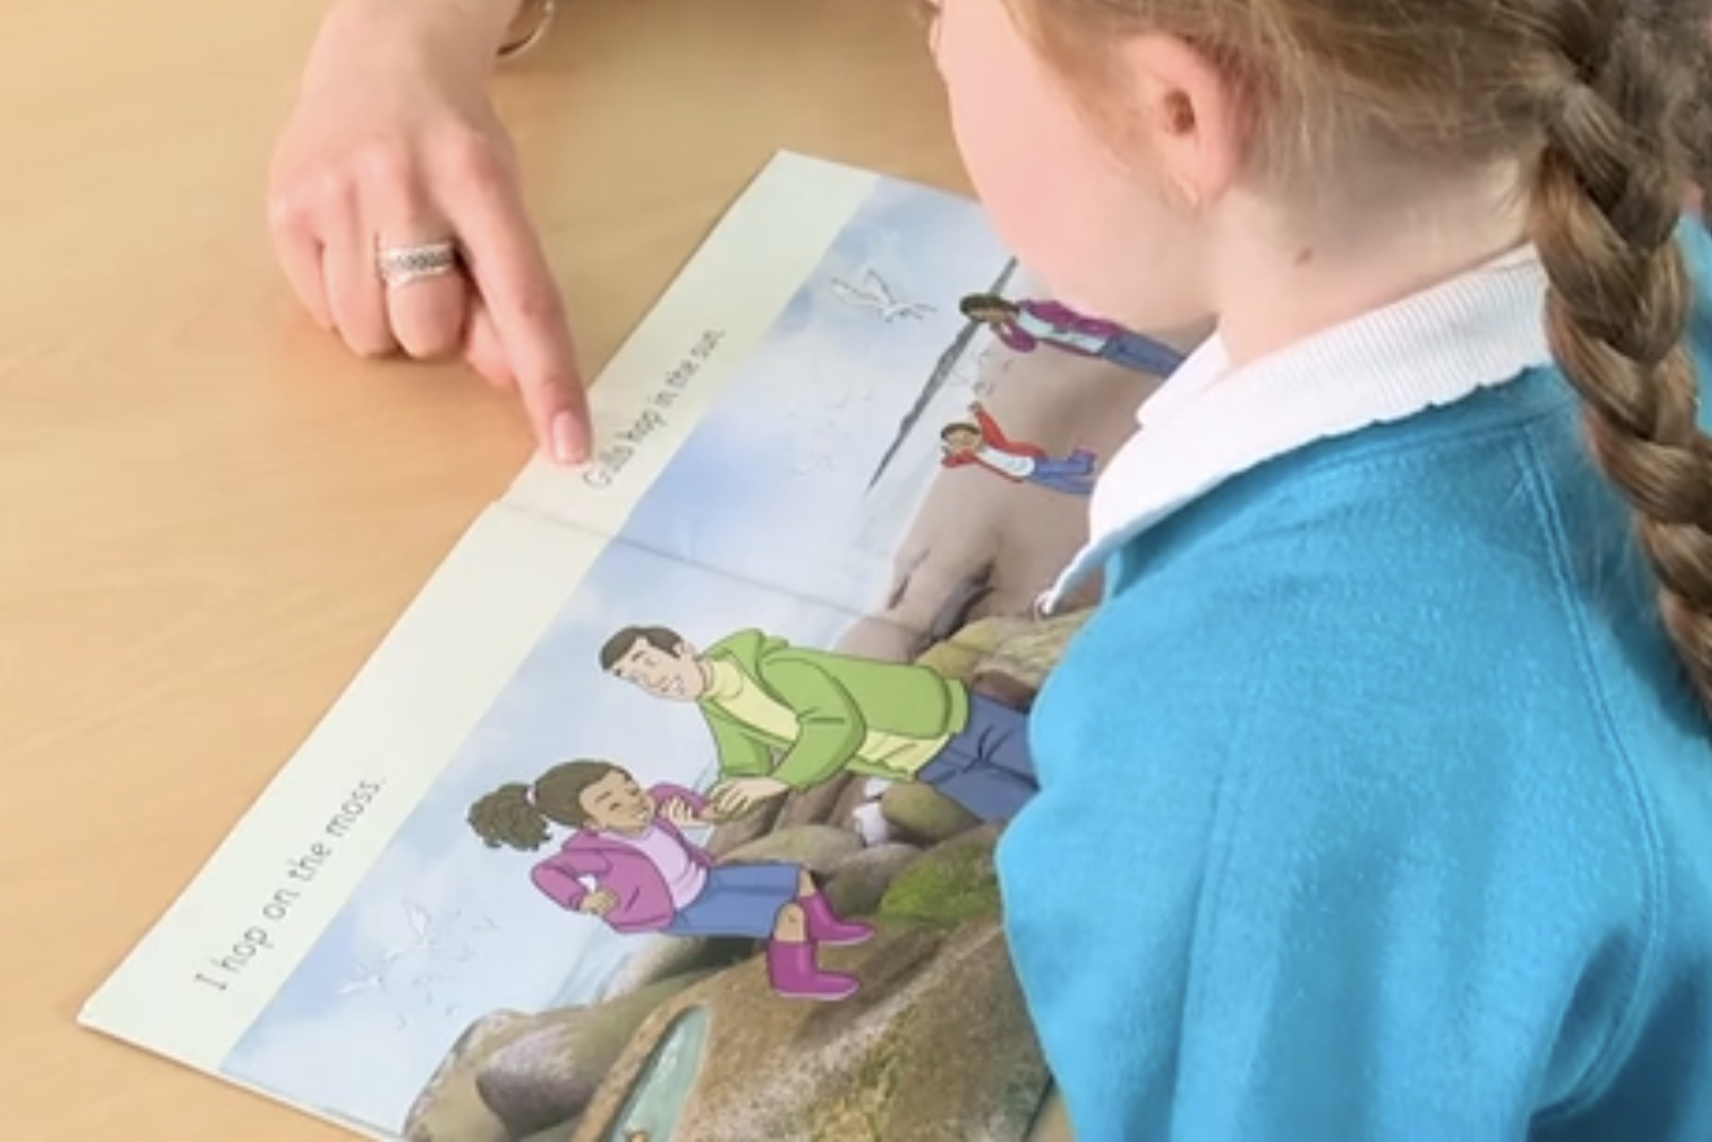
Reading a book at the right level
This means that your child should:
know all the sounds and tricky words in their phonics book well
read many of the words by silent blending (in their head) – their reading will be automatic
only need to stop and sound out about 5% of the words by the time they bring the book home – but they should be able to do this on their own.
Notes:
Slide purpose:
To provide an overview of book matching
Suggested script:
Once your child is reading a Phase 3 book, we encourage them to ‘blend in their heads’ – you will remember that this is one of the strategies we use to help develop children to become fluent readers. (Blending in your head means children say the sounds quietly in their heads and then read the whole word out loud. Eventually, this will become automatic and children can read words that they know fluently.)
We will always communicate with you if we feel that your child is not blending accurately enough yet and needs additional support.

Slide 11
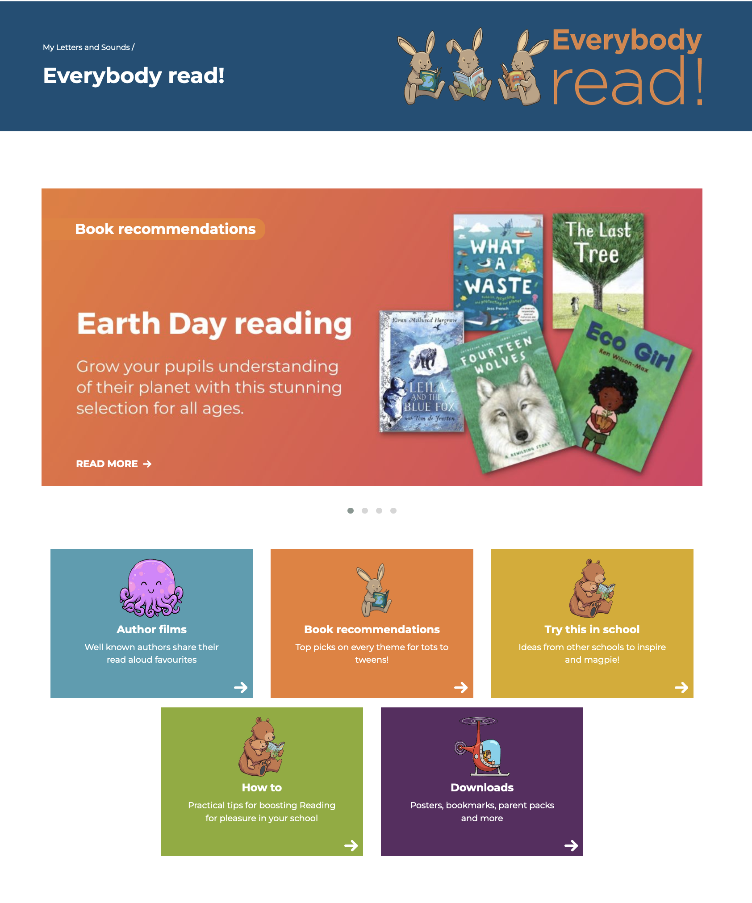
The most important thing you can do is read with your child
Reading a book and chatting had a positive impact a year later on children’s ability to…
understand words and sentences
use a wide range of vocabulary
develop listening comprehension skills.
The amount of books children were exposed to by age 6 was a positive predictor of their reading ability two years later.
Your child should be able to read their book without your help.
If they can’t read a word, read it to them.
Talk about the book and celebrate their success.
Parental involvement in the development of children’s reading skills: A five-year longitudinal study (2002) Senechal, M. and Lefvre, J
Notes:
Slide purpose:
To introduce the values of reading at home
Suggested script:
You play a crucial part in your child's reading and the most important thing you can do is read with them.
Read the slide.
Celebrate your child’s success at school and make time for reading at home.
The Everybody read! part of the Little Wandle website has lots of book recommendations. Anyone can access it and find lots of lovely book recommendations for their children.
Click on link to show Everybody read! section of website: https://www.littlewandlelettersandsounds.org.uk/resources/my-letters-and-sounds/everybody-read/
Don't forget that your local library can order books for you if you really want a specific book.

Slide 12
Read to your child
The shared book is for YOU to read:
Make the story sound as exciting as you can by changing your voice.
Talk with your child as much as you can:
Introduce new and exciting language.
Encourage your child to use new vocabulary.
Make up sentences together.
Find different words to use.
Describe things you see.
Notes:
Slide purpose:
To provide guidance on reading the shared book at home
Only use this slide if your context allows this to be an appropriate expectation (e.g. high levels of deprivation or EAL may not be appropriate to encourage yet).
Suggested script:
Reading to your child daily can open a variety of doors to your child's education, imagination and well-being.
Read the slide.
As a school, we also prioritise reading to the children daily to encourage the love of reading.

Slide 13
Supporting your child with phonics https://www.littlewandlelettersandsounds.org.uk/resources/for-parents
Notes:
Slide purpose:
Guidance on supporting phonics learning at home
Suggested script:
It is really important that you pronounce the sounds correctly at home if you are supporting your child.
These videos are on the website for you to refer to and if you are unsure, please ask your child’s teacher.
Show the parents where to access the videos on the website and play them. https://www.littlewandlelettersandsounds.org.uk/resources/for-parents/
Tell the parents that ‘Little Wandle at Home’ phonics flashcards are available from HarperCollins: https://collins.co.uk/pages/little-wandle-at-home

Slide 14
One of the greatest gifts adults can give is to read to children
Carl Sagan
Notes:
Slide purpose:
Key takeaway/final message
Suggested script:
Read the quote.
Working together will ensure that your children become skilled readers.

